Slide 1
Graphs

Slide 2
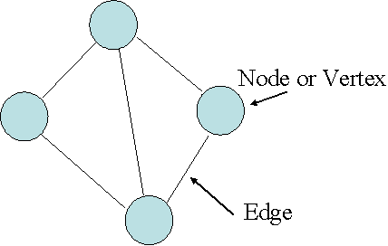
Flight Routes of Thai Airlines
New York
Chiang Mai
Bangkok
Japan
Katmandu
Malaysia
Singapore
New Delhi

Slide 3
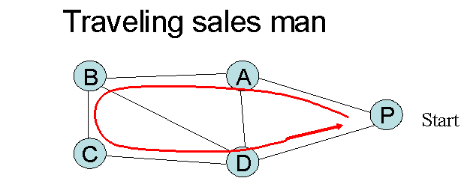
Computer Network

Slide 4
Graph Definition
A graph G = (V,E) is composed of:
V: set of vertices (nodes)
E: set of edges (arcs) connecting the vertices in V
An edge e = (u,v) is a pair of vertices
Example:
a
b
V= {a,b,c,d,e}
E= {(a,b),(a,c),(a,d),
(b,e),(c,d),(c,e),
(d,e)}
c
d
e

Slide 5
Some Terminologies
Adjacent vertices
Two vertices of a graph are said to be adjacent if they are joined by an arc. In the graph below vertices a & c are adjacent but a & e are not.
Predecessor and Successor
If there is an arc from m to n, then n is called a successor of m and m a predecessor of n.
Degree of a Vertex
The degree of a vertex is the number of edges incident to that vertex
The degree of vertex a is 3 and b is 2
a
b
c
d
e

Slide 6
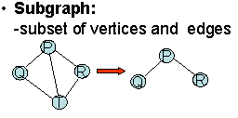
Undirected vs. Directed Graph
Contd.
A
A
B
C
B
C
D
D
Undirected Graph -edge has no arrow head
Directed Graph (Digraph) -edge has arrow head

Slide 7
Contd.
For directed graph,
  the in-degree of a vertex v is the number of edges that have v as the head.
  the out-degree of a vertex v is the number of edges that have v as the tail.
tail
head
Vertices | In degree | Out degree
A | 2 | 1
B
C
D
A
B
C
D

Slide 8
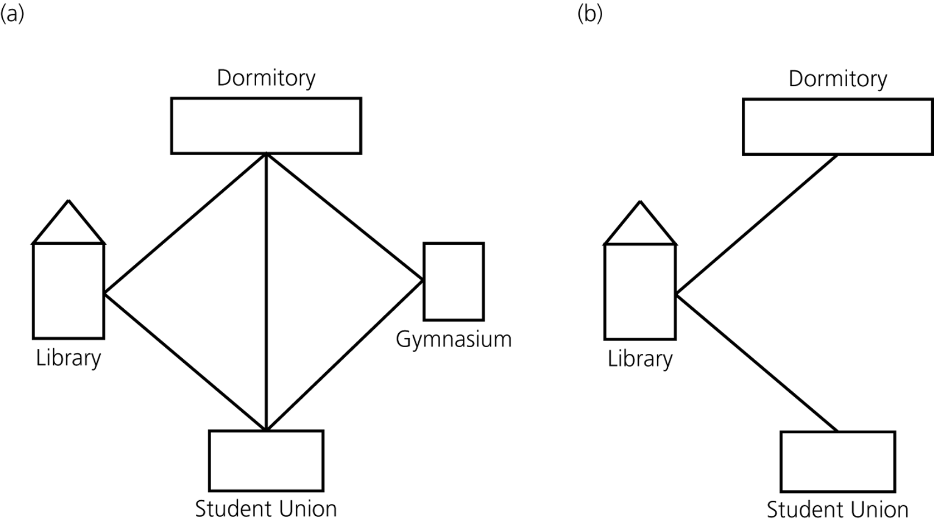
Contd.
a) A campus map as a graph b) a subgraph

Slide 9
Contd.
Path and Simple Path
A path in a graph is a sequence of vertices in which each successive vertex (after the first) is adjacent to its predecessor in the path.
A simple path is a path such that all vertices are distinct.
  ABCD is a simple path
B
A
C
D
path

Slide 10
Contd.
Cycle
A cycle is a path that starts and ends at the same point. For undirected graph, the edges are distinct.
  CBDC is a cycle
B
A
C
D
Distance
0
Consider s=vertex 1
8
2
Nodes at distance 1?
2, 3, 7, 9
1
2
s
9
1
1
Nodes at distance 2?
8, 6, 5, 4
1
3
7
1
6
2
Nodes at distance 3?
0
4
5
2
2

Slide 11
Contd.
Connected vs. Unconnected Graph
An undirected graph is called connected if there is path from any vertex to any other vertex. Otherwise, it is said to be unconnected.
Complete Graph
  if there is an edge between any two vertices
  For n vertices, total no of edges = n(n-1)/2
P
P
Q
R
Q
R
S
S
Unconnected Graph
Connected Graph
A
B
C
D
Complete graph

Slide 12
Contd.
Strongly and weakly connected graph
A directed graph is called strongly connected if there is a directed path from any vertex to any other vertex.
A directed graph is called weakly connected if its undirected graph is connected i.e. the graph obtained after neglecting the direction.
C
C
B
D
B
D
E
E
A
A
F
Strongly connected
Weakly connected

Slide 13
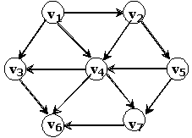
Contd.
Weighted graph: a graph with numbers assigned to its edges
Weight: cost, distance, travel time etc.
0
20
10
1
1
2
Directed Acyclic Graph (DAG) : directed graph without cycle
4
5
3
A
B
C

Slide 14
Representation Of Graph
Adjacency sets
  vertex sets
  0 {1, 2}
  1 {0, 2, 3}
  2 {0, 1, 3}
  3 {1, 2}
Adjacency table
    0 1 2 3
    0 F T T F
    1 T F T T
    2 T T F T
    3 F T T F
0
1
2
3

Slide 15
Contd.
Adjacency List
  An array of list
  the ith element of the array is a list of vertices that connect to vertex i
0
1
2
3
0
1
3
1
2
3
2
3
3
vertex 0 connects to vertex 1, 2 and 3
vertex 1 connects to 3
vertex 2 connects to 3

Slide 16
Contd.
Adjacency List for Weighted graph: extend each node with an addition field i.e. weight
0
1
10
2
20
3
1
0
10
20
1
0
10
3
4
1
1
2
2
0
20
3
5
4
5
3
0
1
1
4
2
5
3

Slide 17
Contd.
  Adjacency Matrix
  If vertices i and j are adjacent in a graph, then A[i][j] = 1, and 0 otherwise. If vertex i has a loop, A[i][i] = 1, 0 otherwise.
0
A[i][j] | 0 | 1 | 2 | 3
0 | 0 | 1 | 1 | 0
1 | 1 | 0 | 1 | 1
2 | 1 | 1 | 0 | 1
3 | 0 | 1 | 1 | 0
2
1
3
0 1 1 0
1 0 1 1
1 1 0 1
0 1 1 0
So, Matrix A =
Note that for an undirected graph, the adjacency matrix is symmetric, otherwise it may not be symmetric

Slide 18
Contd.
Adjacency Matrix for Directed Graph
A[i][j] | 0 | 1 | 2 | 3
0 | 0 | 1 | 1 | 1
1 | 0 | 0 | 0 | 1
2 | 0 | 0 | 0 | 1
3 | 0 | 0 | 0 | 0
0
1
2
3
0 1 1 1
0 0 0 1
0 0 0 1
0 0 0 0
So, Matrix A =

Slide 19
Contd.
Adjacency Matrix for Weighted Graph
A[i][j] | 0 | 1 | 2 | 3
0 | 0 | 20 | 10 | 1
1 | 20 | 0 | 0 | 5
2 | 10 | 0 | 0 | 4
3 | 1 | 5 | 4 | 0
0
20
10
1
1
2
5
0 20 10 1
20 0 0 5
10 0 0 4
1 5 4 0
4
3
So, Matrix A =

Slide 20
Transitive Closure
Mathematical Notation of Adjacency Matrix
Let G=(V, E) be a simple graph in which V={v₁, v₂, …, v_{n}} and E are a set of vertices and edges respectively. An nxn matrix A whose elements a_{ij} are given by
a_{ij} = 1 if (v_{i}, v_{j}) € E
0 otherwise
is called the adjacency matrix of G

Slide 21
Example 1
Consider a graph and its adjacency matrix
Naturally, an entry of 1 in ith row and jth column of matrix A shows the existence of a path of length 1 from node v_{i} to node v_{j}.
v₁
 | v₁ | v₂ | v₃ | v₄
v₁ | 0 | 1 | 0 | 1
v₂ | 1 | 0 | 0 | 0
v₃ | 1 | 1 | 0 | 1
v₄ | 0 | 1 | 0 | 0
v₄
v₂
v₃
0 1 0 1
1 0 0 0
1 1 0 1
0 1 0 0
Matrix A =

Slide 22
Contd.
Let A² denotes the matrix multiplication of A by itself so that
The elements of A² be denoted by a⁽²⁾_{ij} which is the number of different paths of exactly length 2 from v_{i} to v_{j}
Similarly A³ and A⁴ are given by
1 1 0 0
0 1 0 1
1 2 0 1
1 0 0 0
Matrix A² =
1 1 0 1
1 1 0 0
2 2 0 1
0 1 0 1
1 2 0 1
1 1 0 1
2 3 0 2
1 1 0 0
Matrix A³ =
Matrix A⁴ =

Slide 23
Contd.
If we are interested in determining the existence of paths from v_{i} to v_{j}, we need to examine the paths of length less than or equal to n. Such paths are easily determined by the matrix
B=A+A²+A³+A⁴=
The non-zero elements in B determine the total number of paths from v_{i} to v_{j}
3 5 0 3
3 3 0 2
6 8 0 5
2 3 0 1

Slide 24
Contd.
Let us define an nxn matrix P for the graph whose elements are given by
p_{ij} = 1, if there exists a path from v_{i} to v_{j}
= 0, Otherwise
is called the path matrix (reachability matrix) of the graph.
Hence the path matrix P is given by
P =
The path matrix P is called the transitive closure of the graph
1 1 0 1
1 1 0 1
1 1 0 1
1 1 0 1

Slide 25
Example 2
Consider a graph and its adjacency matrix
C
A B C D E
B
ABCDE
0 | 0 | 1 | 1 | 0
0 | 0 | 1 | 0 | 0
0 | 0 | 0 | 1 | 1
0 | 0 | 0 | 0 | 1
0 | 0 | 0 | 1 | 0
E
A
D
0 0 1 1 0
0 0 1 0 0
0 0 0 1 1
0 0 0 0 1
0 0 0 1 0
Matrix A =

Slide 26
Contd.
Consider the logical expression a_{ik}&&a_{kj}. Its value is TRUE if and only if the values of both a_{ik} & a_{kj} are TRUE which implies that there is an edge from node i to node k and an edge from node k to node j.
Thus a_{ik}&&a_{kj} equals TURE if and only if there is a path of length 2 from i to j passing through k.
Consider the expression
(a_{i1}&&a_{1j}) || (a_{i2}&&a_{2j}) || … || (a_{in}&& a_{nj}).
The value of this expression is TRUE only if there is a path of length 2 from node i to node j either through node 1 or through node 2 … or through node n.

Slide 27
Contd.
It means this expression is TRUE if and only if there is some path of length 2 from node i to node j.
Let a⁽²⁾_{ij} be the value of the expression
(a_{i1}&&a_{1j}) || (a_{i2}&&a_{2j}) || … || (a_{in}&& a_{nj}).
If A⁽²⁾ be the matrix determined by a⁽²⁾_{ij}, then it is called the path matrix of length 2. Note that A⁽²⁾ is the Boolean product of matrix A with itself.
The values of the Boolean matrices A⁽²⁾, A⁽³⁾, A⁽⁴⁾ are as follows

Slide 28
Contd.
0 0 1 1 0
0 0 1 0 0
0 0 0 1 1
0 0 0 0 1
0 0 0 1 0
0 0 0 1 1
0 0 0 1 1
0 0 0 1 1
0 0 0 1 0
0 0 0 0 1
Matrix A =
Matrix A⁽²⁾=
0 0 0 1 1
0 0 0 1 1
0 0 0 1 1
0 0 0 0 1
0 0 0 1 0
0 0 0 1 1
0 0 0 1 1
0 0 0 1 1
0 0 0 1 0
0 0 0 0 1
Matrix A⁽³⁾ =
Matrix A⁽⁴⁾ =

Slide 29
Contd.
If the graph has n nodes and we wish to construct a matrix path such that p_{ij} is TRUE if and only if there is some path from node i to node j of any length, then
p_{ij}= a_{ij} || a⁽²⁾_{ij} || …|| a^{(n)}_{ij}
If P is the matrix path for the above graph, then P is called the transitive closure of A.
0 0 1 1 1
0 0 1 1 1
0 0 0 1 1
0 0 0 1 1
0 0 0 1 1
P=
P = A or A⁽²⁾ or A⁽³⁾ or A⁽⁴⁾ or A⁽⁵⁾

Slide 30
Warshall’s Algorithm
Given the adjacent matrix A,
Initialize P←A
Perform a pass repeat through step 4 for k= 1, 2, …,n
Process rows repeat step 4 for i=1, 2, …,n
Process columns repeat for j=1, 2, …,n p_{ij}←p_{ij}v(p_{ik}ʌp_{kj})
Finished

